Slide 1
Give and Take
Global Studies and Collaboration
Kaewmanee Rapeepan 1AY15006
Sathitirat Radamanee 1AY15022

Slide 2
Nowadays, Around the world have many problems in children. Such as disadvantaged child. So we think we want to do this campaign for them.

Slide 3
Purpose
Donate cloths and books to disadvantaged child.
Encourage people to make use of the time wisely.
For promote application (Ingress)

Slide 4
About activity
We’ll Meet-up at Aoyama Gakuin University main gate.
Please donate something(cloth or book).
After registered we’ll give some Ingress’s souvenir to you.

Slide 5
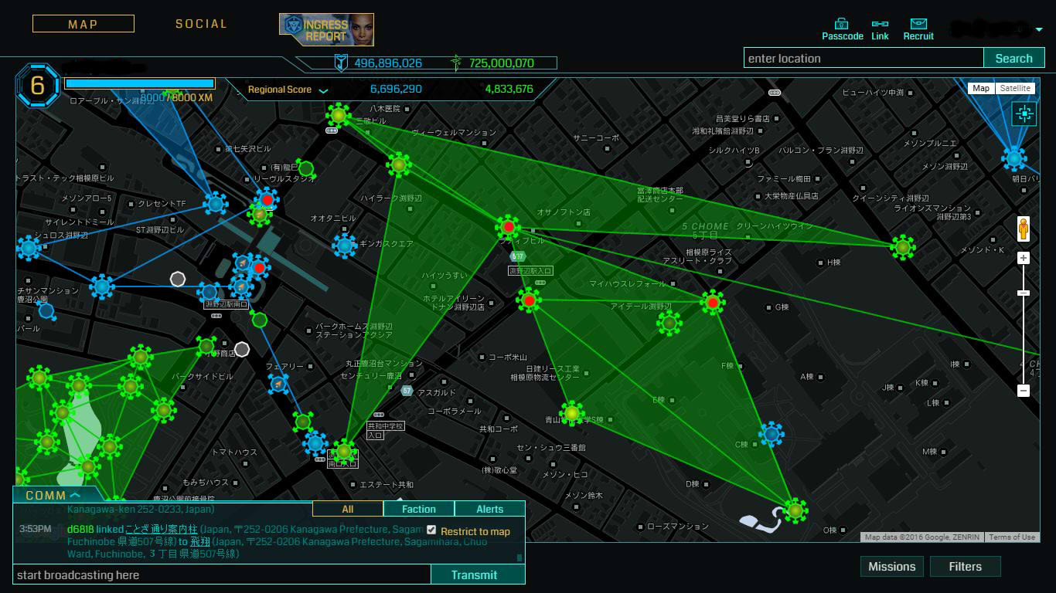
This campaign we’ll walk around Fuchinobe city and complete 5 missions.

Slide 6
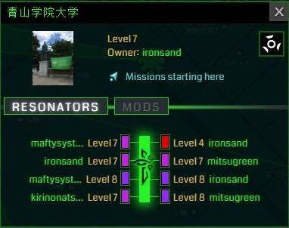
Aoyama gakuin University
Point 1

Slide 7
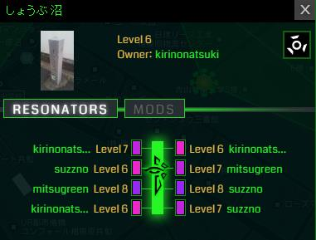
Shoubu kuga
Point 2

Slide 8
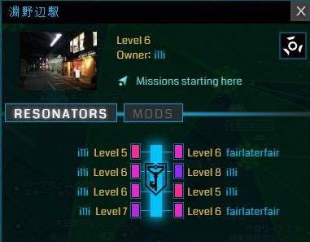
Fuchinobe Station
Point 3

Slide 9
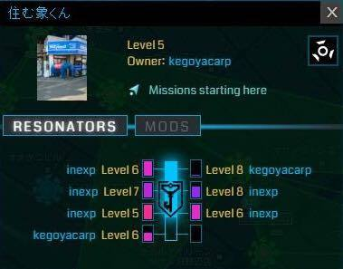
Sumu zoukun
Point 4

Slide 10
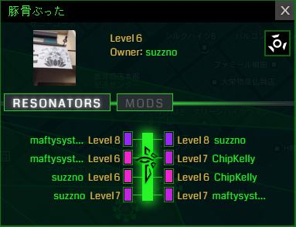
Tonkotsu butta
Point 5

Slide 11
Rule
Mission start at Aoyama Gakuin University.
We give checkpoint card for participants.
We don’t fix route. So, you can choose the portal you want to go.
Every portal it’s have some game or quiz.
You have to complete 5 all of portal in 1 hour.
The winner will get prize.

Slide 12
Thank you!!

